Slide 1
UNDERSTANDING CORPORATE SPONSORSHIP
TOURISM BARRIE
A View of the What, How and Why for Tourism Barrie and their Partner Organizations
September 29, 2020

Slide 2
BRENT BAROOTES
President and CEO
Notes:
Cover off background in 30 to 45 seconds
Personal and who and what PG is

Slide 3
Where to find me…
brent@partnershipgroup.ca
@partnershipgrp
@sponsorshipspecialist
www.linkedin.com/in/brentbarootes
Notes:
Share slide – focus on email and LinkedIn

Slide 4
TUESDAY MORNING COMMENTARY TMC
www.partnershipgroup.ca

Slide 5
The Evening Plan
What is corporate sponsorship?
How does corporate sponsorship marketing really work?
Why should corporate sponsorship be important to your organization?
Wrap up - Questions
Notes:
What is the difference between sponsorship, advertising, donations / philanthropy and grants?
What are the key 5 elements that it takes to achieve success sin this whether you are a huge or small organization?
Why:
Own a venue, like the City or private facility
For top level sport organizations like 1812 FC - Barrie’s Semi Pro soccer team
Competitive teams like AAA Colts Hockey Club
Sport association like Minor Hockey, Soccer or Cricket
For recreational level sport organizations like Barrie Pickle Ball Club
Local gymnastics club, football team,
Host events / fundraisers, tournaments, bringing in events and provincials or regionals
The Q and A

Slide 6
Notes:
I understand this is a cross section of volunteers, board members, front line volunteers, staff etc.
In our industry of sport… we all wear many hats
This session will hopefully be eye opening for you and also understand you cannot do all of it because you are all too busy, but hopefully can take away and implement some of it
This session will make you feel a little uncomfortable – I hope – because if it doesn’t we are doing something wrong because for many of you, you will push back and say “that’s not the way we do it around here”… so a quick slide before we get started …

Slide 7
What has changed in the marketplace?
The marketplace has become competitive:
Charities in the game
Non profits and member associations
Pro and amateur sport
Municipalities
People holding “turf”

Slide 8
The Definitions
We will look at Philanthropy and Grants first…
Then we will define sponsorship and how it is different from advertising
Critical you understand all of these to be successful

Slide 9
Defining Philanthropy
A gift with nothing in return
Based on the cause, the linkage, wanting to help
Delivers a feeling of doing good
CRA compliance
Notes:
They get nothing back… sometimes you call this sponsorship but It really isn't

Slide 10
Defining Grants
Support in exchange for specific outcomes both for the project and grant provider
Can have some elements (exposure and profile) of sponsorship assets
Real focus is that they give you money for specifics and you have to stick to those
Notes:
Use examples like Jump Start, Service Clubs, Foundations
Really detailed but worth it
Might be specifically for a staff person or a to run a program itself

Slide 11
Defining Sponsorship Marketing
A cash and/or in-kind fee paid to a property such as Mariposa Skating Club (or whoever) in return for the commercial potential associated with Mariposa Skating Club.
This is a B2B transaction which each party puts up some value and gets value in return.

Slide 12
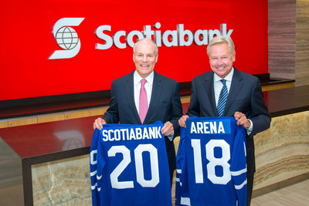
Defining Advertising vs Sponsorship
Notes:
Define advertising and focus on how it is different

Slide 13
How Does Corporate Sponsorship Marketing Really Work?
The 5 Elements to Success
Understand this is about sponsor’s needs not yours
Understand what those needs are of the sponsor
Custom build a program that will work for them
Continually communicate and come with further opportunities and ideas for them
Deliver on what you promised

Slide 14
The 5 Elements to Success
Understand this is about sponsor’s needs not yours
Notes:
Shift your mind from thinking about you and your organizations need to the needs of the sponsor
Just like when you go into a retail store…. Do you want the salesperson to say “hey please buy this pair if skates, I need the sale and commission to make my rent payment this month…. I don’t care that you came in to ask about baseball gloves, this is what we have to get off our shelves and we need the money”… so how is that different from you and tour sponsors
Shift from all about you to all about them
Find out about their business, their needs
If you prospect correctly you will be talking to folks who want to reach your audience
Know who your audience is and who wants to reach them
Families… then what about mini vans and grocery stores and amusement parks versus banks and cell companies
Stop going after the money and go after who you can help
So for instance a cricket club is typically new Canadians from SE Asia and the Caribbean countries – so who is it that want to reach this audience from B2B or retail?

Slide 15
The 5 Elements to Success
Understand what those needs are of the sponsor
Notes:
This means you need to do discovery sessions
Meet with them face to face or virtually and don’t sell or pitch them, ask about their business
Learn what their struggles are (sales, leads, web access, staffing retention, staffing hiring, community image, new product launch etc.
Figure out what they are doing to market now and how it is working and how they measure success
Determine budgets
Now you can build a proposal and not before

Slide 16
The 5 Elements to Success
Custom build a program that will work for them
Notes:
Move away from stock packages
Custom build… what the local pizza place needs (driving traffic Sunday to Wednesday) is different what the accounting firm needs so the same assets won’t work
If you are going to buy skates – there could be figure skates, speed skating skates or hockey skates or goalies skates…. All would have different target markets, but all are still skates
Use Coke and Pepsi example of Canada Games
Some want tickets, some want logos, some want activations or sampling
Give them what they need and want versus a whole pile of stuff they don’t want or need

Slide 17
The 5 Elements to Success
Continually communicate and come with further opportunities and ideas for them
Notes:
First off this means learn to listen…

Slide 18
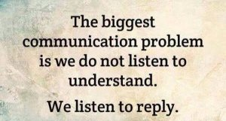
Notes:
We need to learn to listen to learn…
Stop listening to respond and learn to listen to actually learn
Goes for brands and properties
SO WHAT DOES THIS ACTUALLY MEAN?
Stop selling properties – stop trying to pitch product and start understanding the brand, their needs and become a solution provider
Brands need to share their needs, their hurt, their issues, their successes and failures with the properties – a doctor can only help prescribe a cure when they know all the facts
Both need to do the research – who is the audience you deliver, are seeking and truly what do they want, need, believe in….? Get it right

Slide 19
The 5 Elements to Success
Continually communicate and come with further opportunities and ideas for them
Notes:
In the TMC a few weeks back I wrote about ABC used to be “always be closing” now it is “always be communicating”
Come to them with new ideas even after the season or program has started
Sometimes you charge them extra sometimes you don’t
Working with a client last week who was so excited because their partner was going o run a full campaign over Christmas and promote them and their association to them on TV and radio and also have all their staff volunteer at their Christmas fundraising events… they thought that was so great… I burst their little balloon and said “what the heck are you doing for them”? They sat there like deer in the headlights on the Zoom call…. I said how can you help them with those media messages, what people can you supply for interview, what audio and video do you already have in the can they can use, what research can you provide them with around your cause…
For the volunteering side why are you not suggesting they produce t-shirts or coats for all their staff using both your logo and the company logo and saying proud to volunteer on them – that lets everyone else at those events know that this company and your organizations are partners (great for the company); also lets everyone at the events know that company’s staff are great people and they are volunteering and also makes the employees feel proud to wear the shirts or coats and then they wear them after AND if it is multiple years they can collect them
These are the ideas you need to bring to your partners – always be communicating
Dates change for your tournament; layers change, venue changes… your sponsors should know before the public… brining in a celebrity… sponsors should know before the media

Slide 20
The 5 Elements to Success
Deliver on what you promised
Notes:
Fulfilment is critical; make sure you have a system to track deliverables for each sponsor
Make sure they get everything and where you can over deliver, do so
Write fulfilment reports

Slide 21
Understand you need to change but it happens over time, but change is inevitable if you are to succeed
The Electric light did not come from the continuous improvement of candles
Owen Harari

Slide 22
Why Should this be Important to Your Organization?
If your organization has or delivers any of the following… sponsorship marketing is important to you or should be:
Own a venue, park, facility
If you have athletes / parents / fans associated to your organization
Host events, tournaments or bring groups together

Slide 23
Why Should this be Important to Your Organization?
It is additional revenue above and beyond fees
Perhaps gravy or a key part of budgets
Can allow you to provide cash back to annual fees
Can allow you to deliver better programs
Can assist in you preparing for a bid
Can assist you in making more profits
Notes:
It is additional revenue channel above and beyond fees and other sources of revenue – could be as much as 50% of your annual revenue and no less than 20%
Perhaps gravy to some organizations (20%) or a key part of budgets (50%) to others
Can allow you to provide cash back to annual fees or lower fees
Can allow you to deliver better programs, coaching, training, activities and opportunities
Can assist in you preparing for a bid for a regional, provincial or national event hosting opportunity
Can assist you in making a major evet profitable or even legacy driven

Slide 24
Example of an activation from Honda and Little League

Slide 25
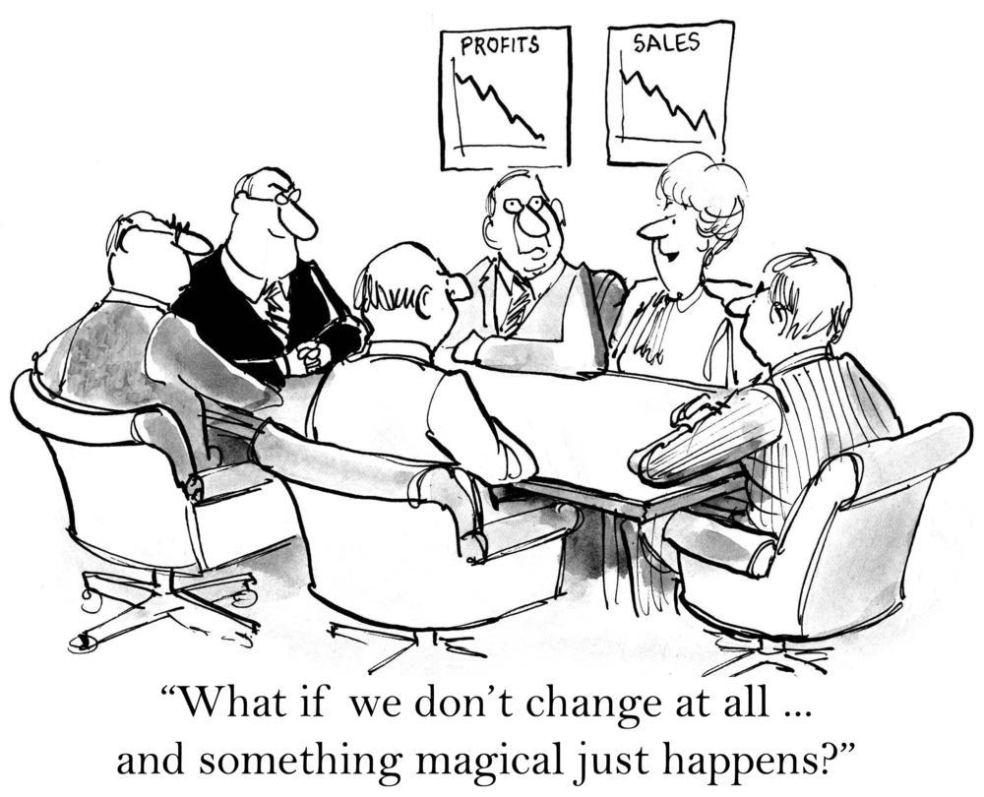

Slide 26
QUESTIONS?

Slide 27
Thank You

